Slide 1
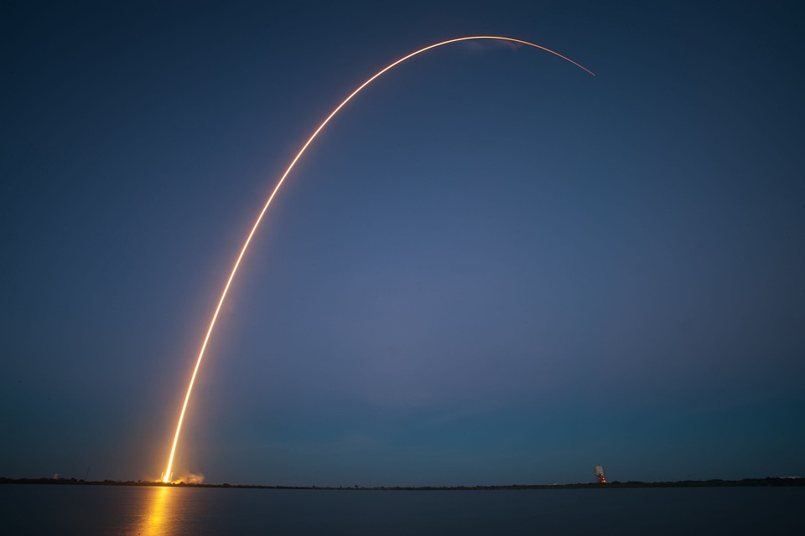
Exploring Space Missions: From the Space Race to the Present
Akshay Channam Geethika Elaprolu Keerthi Yalamanchili

Slide 2
Abstract
This project explores global space missions from 1957 to 2020 using data visualization to identify significant trends, key contributors, and mission outcomes.
Key Focus Areas:
Historical trends in mission launches.
Geographical and temporal analysis of space activities.
Uncover trends in space exploration, identify key players in the industry.
Analyze patterns in launches, and financial investments over time.
Success and failure rates of missions by companies and countries.
Objective:
To create compelling visualizations that narrate the evolution of space exploration, highlight the growing role of private companies, and provide actionable insights.

Slide 3
Introduction
Space exploration has fueled humanity’s imagination, pushing boundaries of science and technology.
The Space Race (1957-1975): Sparked technological innovation, marked by Sputnik and Apollo missions.
Modern Era (2000 onwards): Rise of private companies like SpaceX and Blue Origin.
Why This Matters:
Understand the historical impact of space exploration.
Study the transition from government-driven missions to commercialization.
Uncover the factors behind successful missions.
While existing visualizations focus on basic metrics, our work bridges this gap with interactive and visually compelling representations, offering a fresh perspective on the legacy and future of space exploration.

Slide 4
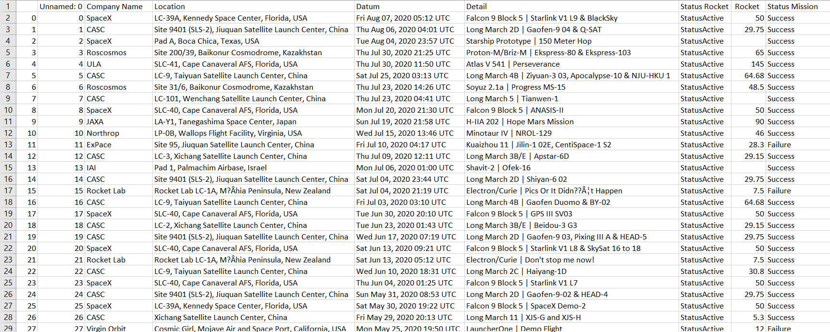
Dataset

Slide 5

Dataset Description
We analyzed a dataset covering space missions from 1957 to 2020, with over 4,324 entries.
Source: Data scraped from NextSpaceFlight.com and available on Kaggle.
Key Features:
Company Name: Organization responsible for the mission (e.g., NASA, SpaceX).
Location: Geographic site of the launch.
Datum: Date and time of the launch.
Rocket: Cost of the rocket (if available).
Detail: Description of the mission and payload.
Mission Status: Success, failure, or partial success.
Status Rocket: Operational status of the rocket.

Slide 6
Data Types
The dataset includes a mix of data types, enabling diverse visualization techniques:
Nominal Data: Categorical values like Company Name, Mission Status, Status Rocket
Ordinal Data: Ordered values like the m (Datum).
Ratio Data: Numerical values such as rocket costs (where available).
Text Data: Mission descriptions (Detail) providing qualitative insights.

Slide 7
Data Adequacy
The dataset is well-suited for trend analysis and visualization:
Strengths:
Covers over six decades of space missions.
Rich details on launch locations, dates, and outcomes.
Comprehensive view of both private and government-led missions.
Challenges:
Missing values in rocket costs.
Inconsistent naming of locations and organizations.

Slide 8
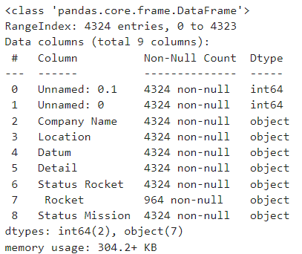
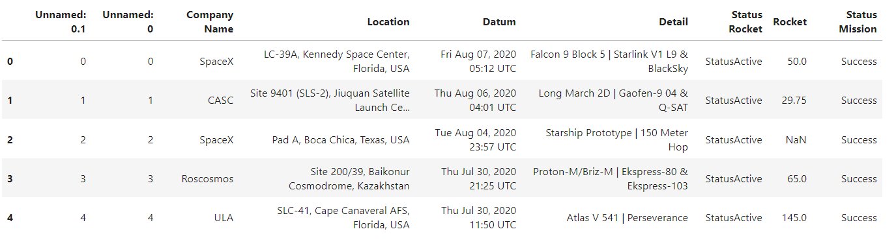
Before Preprocessing:

Slide 9
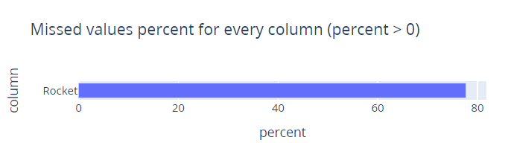
Data Preprocessing
To prepare the dataset for analysis, we performed the following steps:
Dropped Unnecessary Columns: Removed Unnamed: 0 and Unnamed: 0.1 columns.
Standardized Column Names: Removed leading and trailing spaces for consistency.
Cleaned Rocket Cost Data:
Filled missing values with 0.0.
Converted the Rocket column to numeric format for analysis.
Extracted Year Information: Created a new year column by extracting the year from the Datum column.

Slide 10
Geographical Standardization
To ensure consistent geographical analysis, we:
y
Derived the country from the Location column.
Mapped Ambiguous Locations: Used a dictionary to resolve specific cases:
"Russia" → "Russian Federation"
"Yellow Sea" → "China"
"Gran Canaria" → "USA"
Result: A unified Country column for accurate geographical analysis.

Slide 11
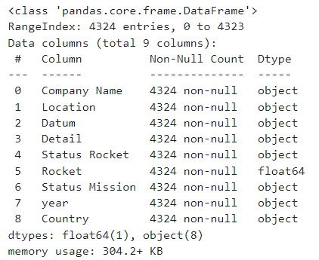
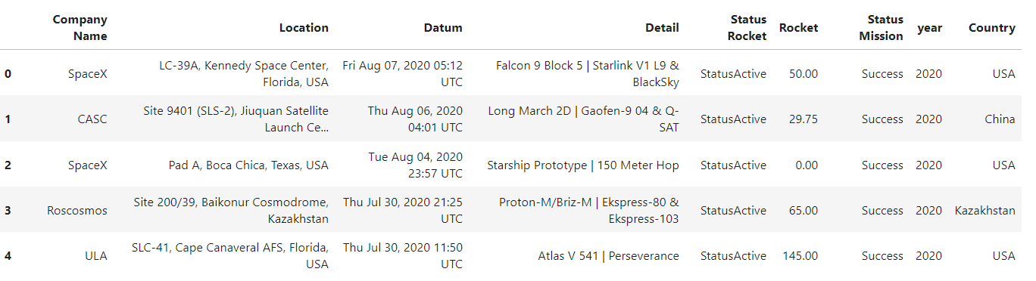
After Preprocessing:

Slide 12
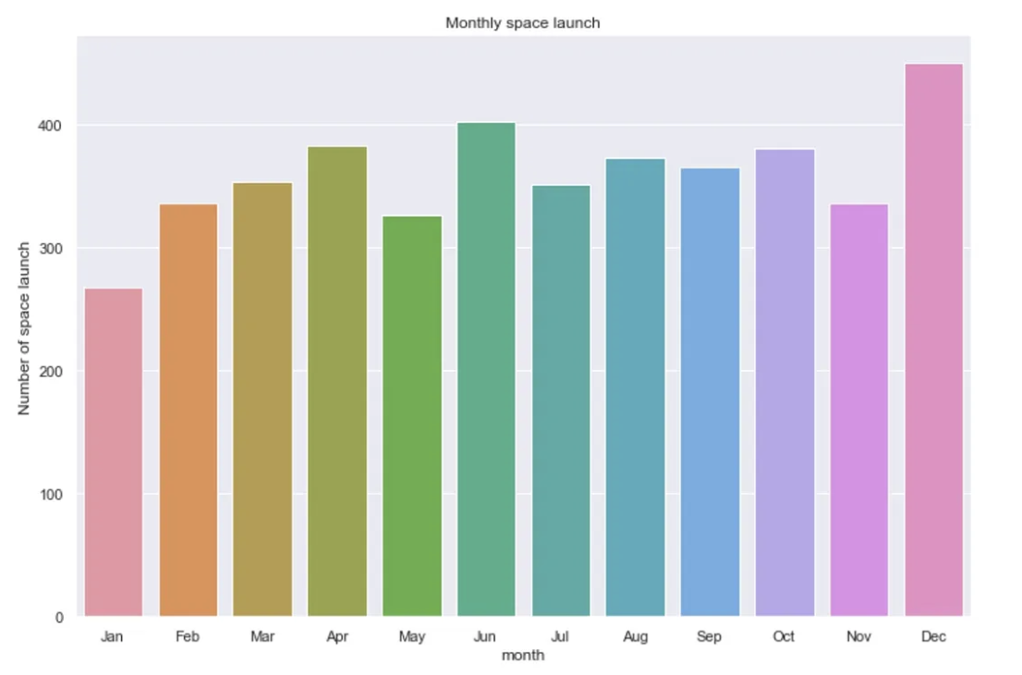
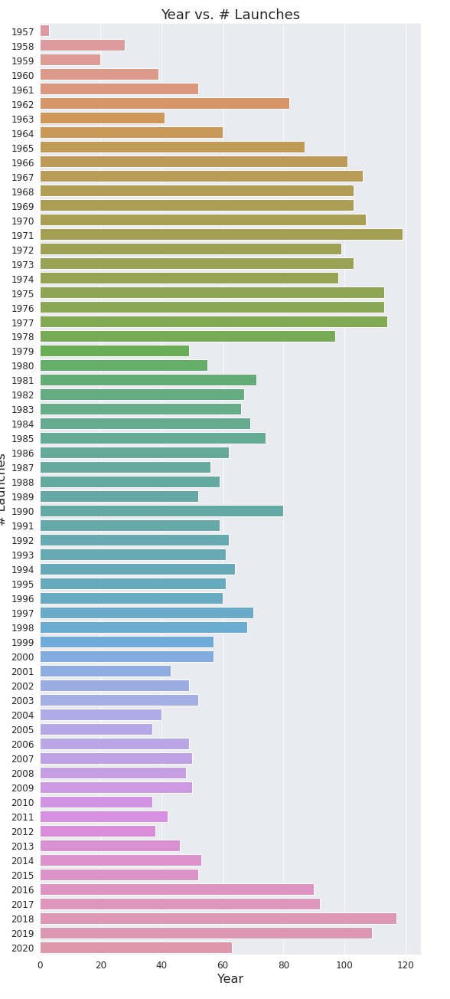
Bad Visualization
Thoughtless Use of Color
In this example of bad data visualization, colors have been randomly assigned to represent different objects.
While the colors may create an aesthetically pleasing chart, they contribute nothing to our understanding of the data.
In fact, instead of adding clarity, the colors create visual noise that detracts from the data's message.

Slide 13
Existing Visualization

Slide 14
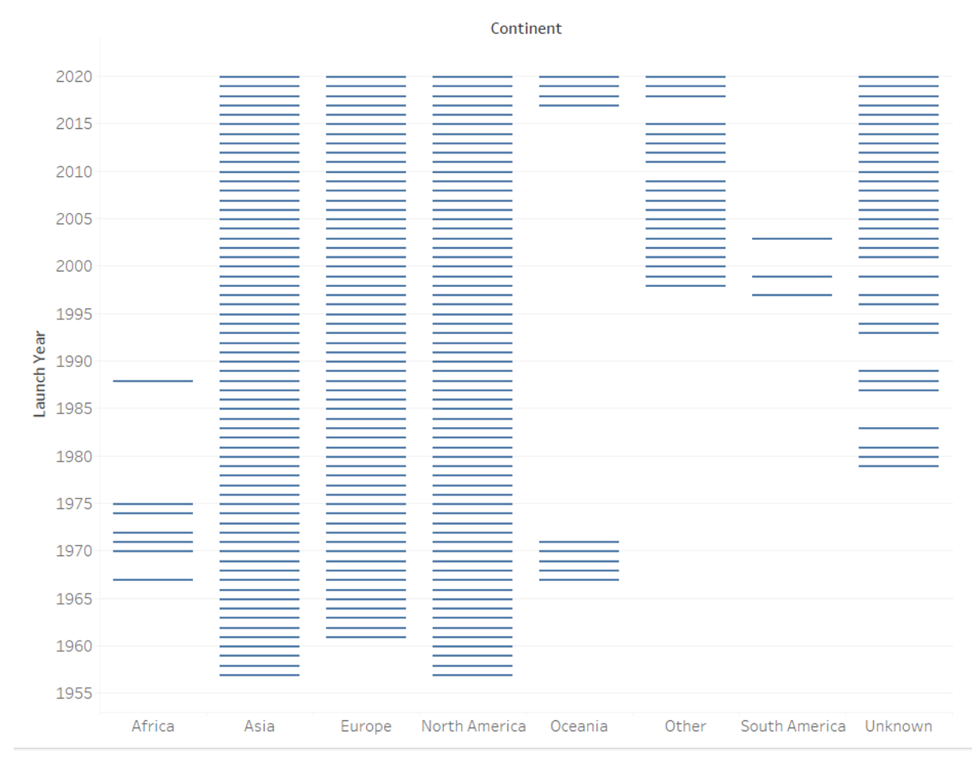
Gantt chart to understand which continent has continuously doing space missions
Insights:
Space missions have been consistently dominated by North America, Europe, and Asia, with a significant surge in activity post-2000, reflecting technological advancements and heightened interest in space exploration.
Africa, Oceania, and South America have minimal contributions, highlighting economic or infrastructural challenges in these regions.
Use of Gantt Chart:
The Gantt chart visually captures the timeline and density of space missions across continents, offering a clear and comparative view of global space exploration trends.

Slide 15
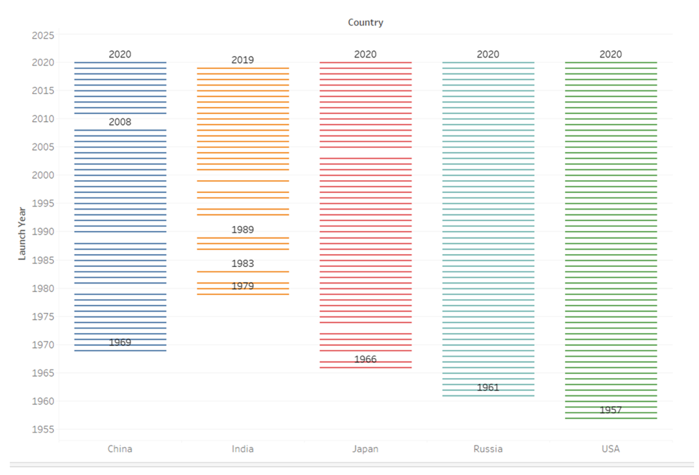
Evolution and Current Trends in Space Exploration: Top 5 Countries
Insights:
Historical Beginnings and Growth:
The USA and Russia pioneered space exploration in the 1950s and 1960s, maintaining leadership roles over decades. China and India, though late entrants in the 1970s and 1980s, have shown significant growth in recent years, rapidly expanding their programs.
Current Trends and Mission Intensity:
All five nations remain actively involved as of 2020, with India and Japan showing increased mission frequencies. The dense mission timelines for the USA and Russia underscore their dominance, while China’s rapid scaling highlights its ambitious goals.

Slide 16
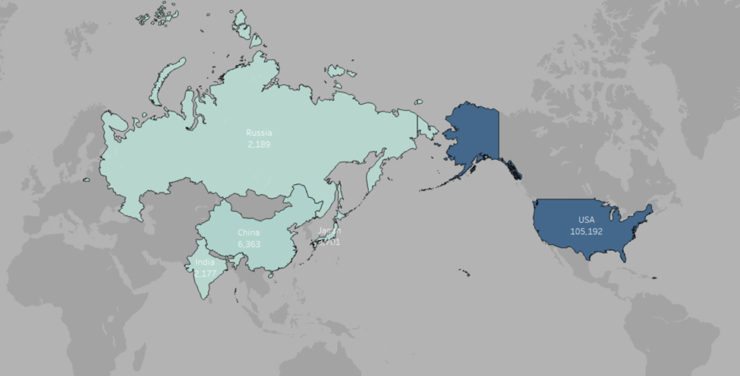
Global Space Expenditure: A Comparative Overview of the Top 5 Players
Insights:
Leadership in Space Expenditure: The USA leads with the highest spending, reflecting its dominant position in space exploration.
Comparative Expenditure Analysis: Russia, India, and Japan allocate modest budgets compared to the USA and China, indicating varying priorities.
Economic and Strategic Implications: Higher expenditures in the USA and China showcase their focus on technological advancements and ambitious missions.
Drawbacks of the Design:
The absence of a legend makes expenditure ranges unclear.
Suggested Improvements:
Add a detailed legend to clarify expenditure levels for better interpretation.

Slide 17
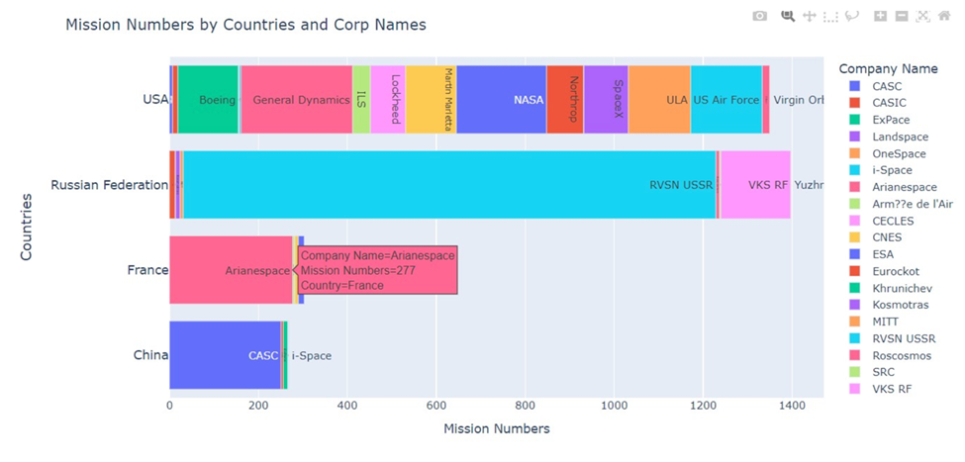
Mission Contributions by Countries and Corporations
Insights:
USA's Diverse Leadership: The USA dominates mission counts, with significant contributions from multiple corporations like SpaceX, NASA, and ULA, showcasing its leadership and collaboration in space exploration.
Russia's Legacy and Current Impact: Russia displays strong contributions through legacy institutions like RVSN USSR and current entities like Roscosmos and VKS RF, emphasizing its historical and ongoing role.
Key European Player: France, with Arianespace, represents a focused yet impactful contribution to European space missions.
Emerging Space Leaders: China shows growing activity with CASC as a leading corporation, while India is emerging with increasing mission numbers.
Drawbacks of the Design:
Similar colors for corporations within the same country make differentiation challenging.
Suggested Improvements:
Use distinct or grouped shades for corporations under each country to improve clarity.

Slide 18
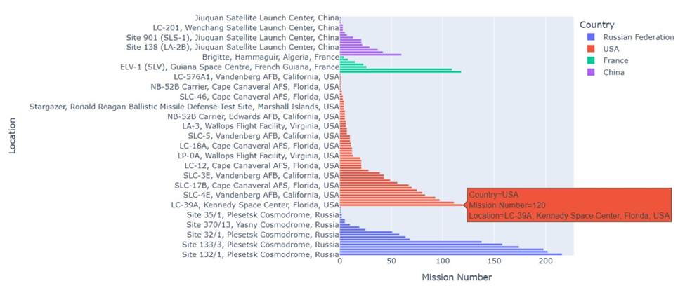
Space Missions by Launch Site and Country
Insights:
USA's Extensive Infrastructure: The USA dominates with prominent launch sites like Kennedy Space Center and Cape Canaveral, reflecting its leadership and well-developed infrastructure for diverse missions.
Russia's Key Sites: Russia leverages historic launch sites such as Plesetsk and Baikonur Cosmodromes, highlighting their ongoing strategic relevance in global space exploration.
France and China’s Targeted Contributions: France and China maintain fewer but impactful sites like the Guiana Space Centre and Jiuquan Satellite Launch Center, emphasizing strategic regional investments.
Strategic Role of Launch Sites: High mission concentration at certain sites like Kennedy Space Center underscores the advanced capabilities and strategic importance of such locations.
Drawbacks of the Design:
Overly long bars can misrepresent relative mission counts.
Densely packed labels make it challenging to read site-specific details.
Suggested Improvements:
Abbreviate lengthy site names to minimize visual clutter.
Use logarithmic scaling to better differentiate mission counts across sites.

Slide 19
Exploratory Data Analysis

Slide 20
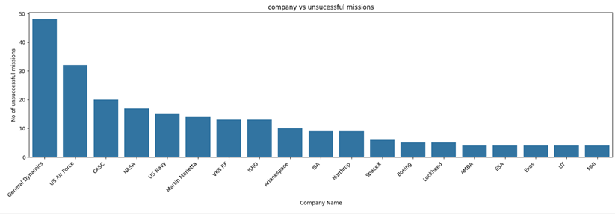
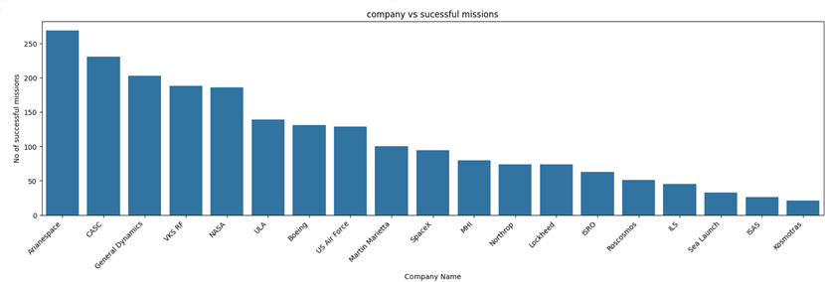
Mission Success and Failure Analysis Across Companies
Organizations like NASA and RVSN USSR have both the highest success rates and the highest failure counts due to their long operational history and ambitious missions.
Companies like SpaceX and Rocket Lab show significant success, but their failure rates highlight the risks associated with innovation and rapid scaling.

Slide 21
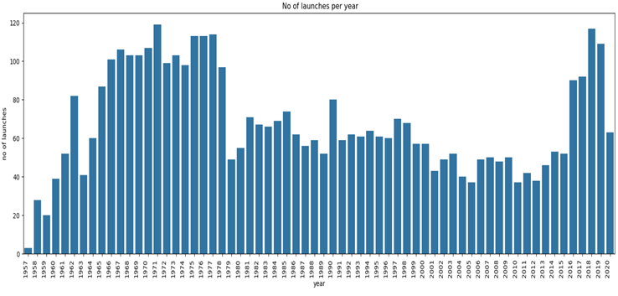
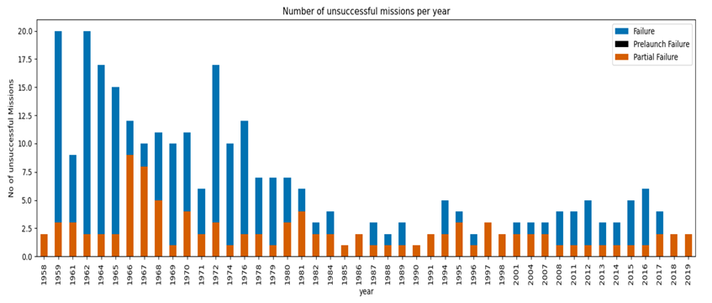
Analysis of Space Launch Trends and Mission Success
Early years with high launch volumes saw a proportional increase in failures, reflecting the experimental nature of space programs.
Milestone missions like lunar landings (1969-1972) and Mars exploration projects introduced risk but delivered transformative achievements.
Recent trends show higher success rates despite increasing launch frequencies, highlighting the industry's growth in reliability.
Continuous investment in innovation and technology reduces failure rates.

Slide 22
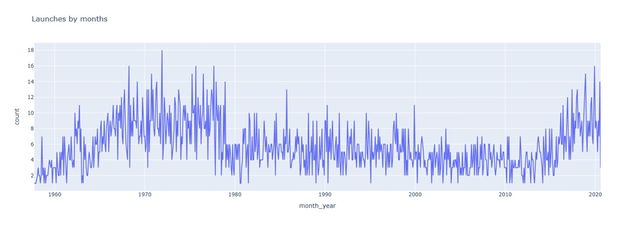
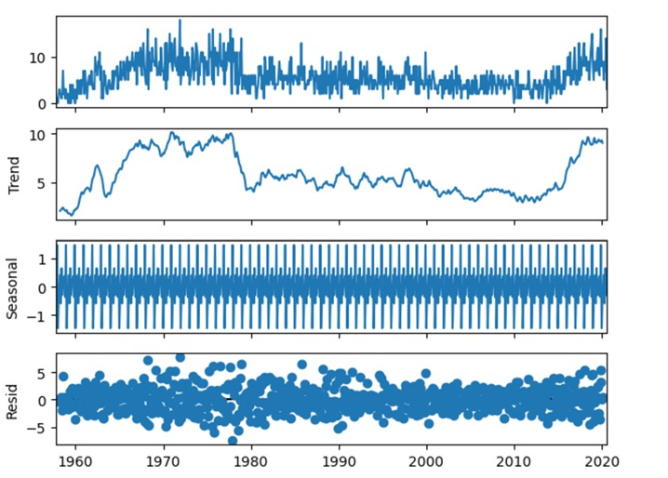
Trends and Patterns in Space Launches
Space launch attempts have shown consistent growth over decades, with notable peaks such as December 1971 and accelerated activity in recent years driven by technological advancements.
The decomposition analysis breaks the launch data into three components: trend, seasonality, and residuals.
The trend highlights long-term growth in launches, while seasonality underscores cyclical patterns driven by operational or environmental factors.
Analyzing these trends aids in forecasting future launch activity, enabling better resource allocation, mission planning, and preparation for peak activity periods.

Slide 23
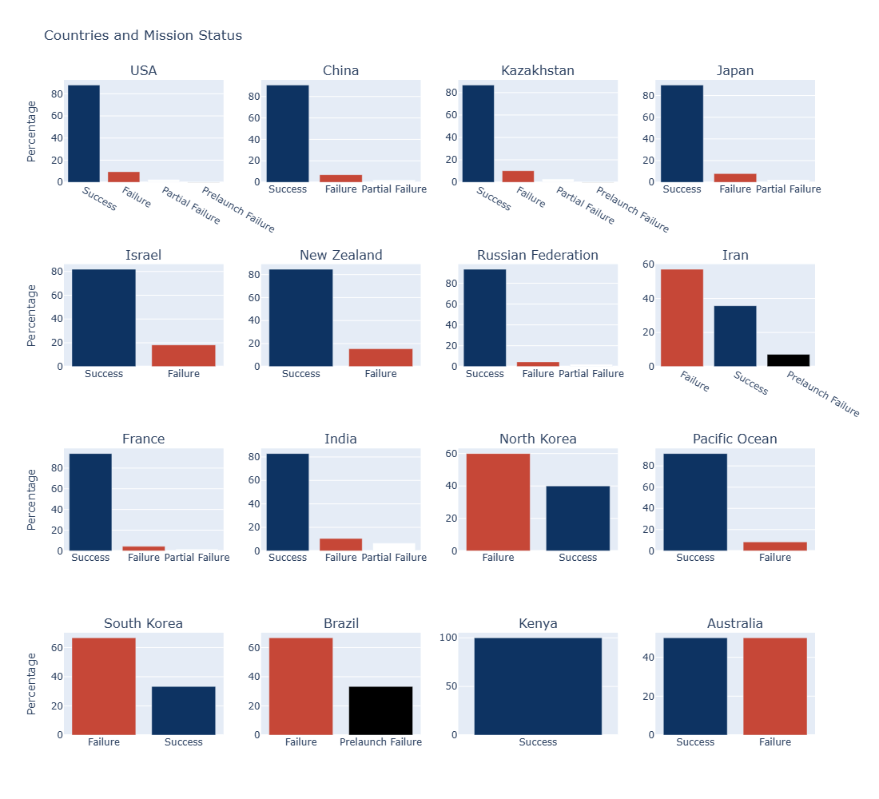
COUNTRIES IN THE SPACE INDUSTRY
The provides a breakdown near-perfect success rates of USA, China, Russia, France, and India space-faring nations.
Smaller nations like Israel and New Zealand maintain high success rates despite limited activity, showcasing precision and focus.
Failure rates are relatively higher for nations like Iran, Brazil, and North Korea.
Developing countries must focus on improving infrastructure, testing, and international collaboration to minimize failures and optimize outcomes.

Slide 24
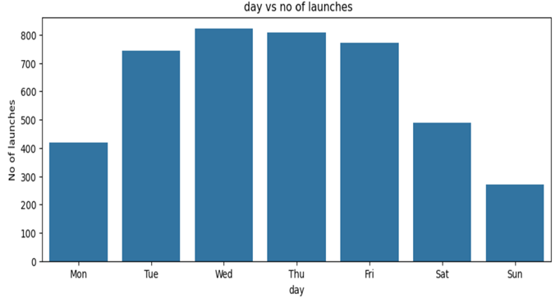
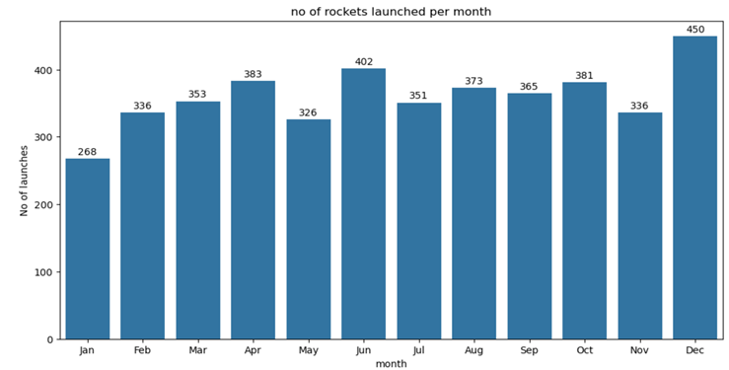
Analysis of Launch Patterns Based on Day and Month
Weekday launches are more frequent, likely due to operational efficiencies, availability of key personnel, and more predictable weather conditions.
December sees the highest number of launches globally, possibly due to favorable weather conditions or mission deadlines, while January has the fewest launches, potentially due to post-holiday slowdowns or adverse weather in several regions.

Slide 25
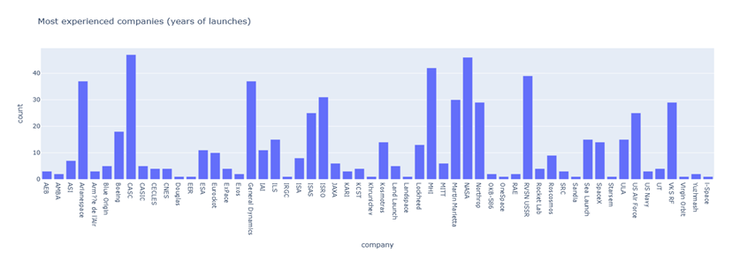
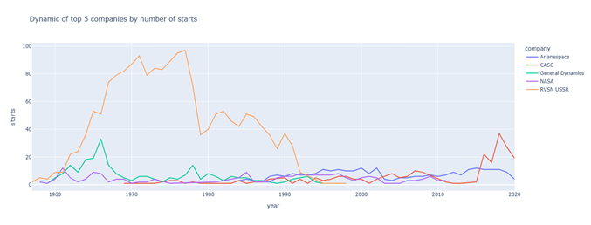
Legacy vs. Emerging Players in the Space Sector
Legacy organizations dominate the list(RVSN USSR, NASA, and Northrop), showcasing the importance of institutional history and expertise in the space sector.
RVSN USSR peaked in the 1970s and 1980s but saw a decline post-1990, NASA maintained steady performance, Arianespace shows consistent growth.
CASC (China Aerospace Science and Technology Corporation) has experienced exponential growth in recent years, signaling China's rise in the space race.
Strategic Evolution:
Long-standing players rely on institutional experience and governmental support.
Newer companies leverage innovation and cost efficiency to challenge traditional leaders.

Slide 26
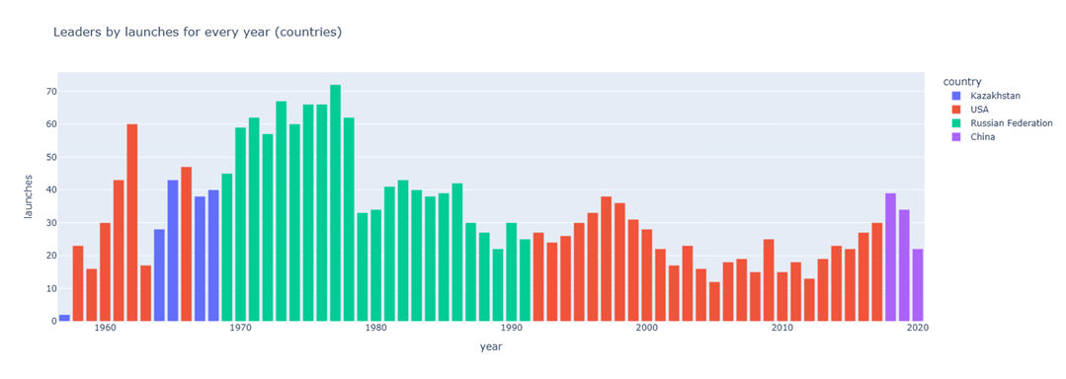
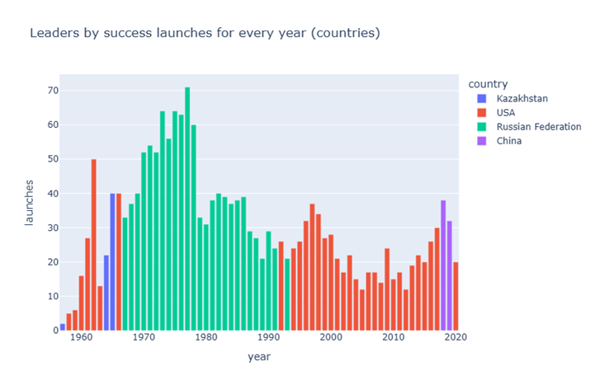
Leaders in Space Exploration(countries)
The USSR led in the number of successful missions in earlier decades, while the USA takes over in later years.
We notice China's rapid rise in the last two decades.
Strategic Implications:
Emphasis on the reliability and technological advancements over time.
Opportunities for international collaboration in space exploration.
The shift from state-driven programs to private-public partnerships.

Slide 27
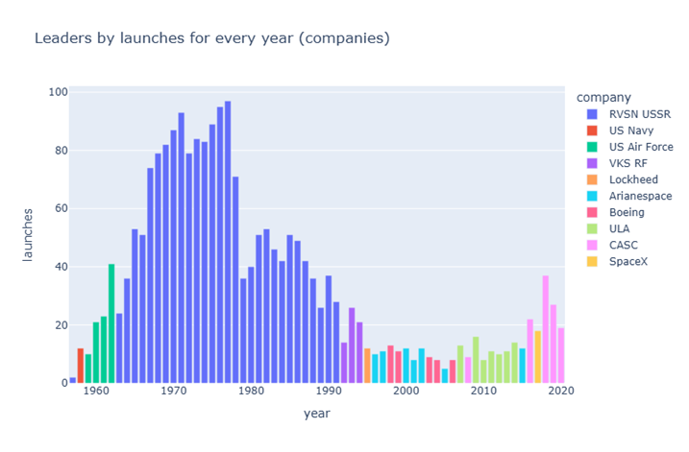
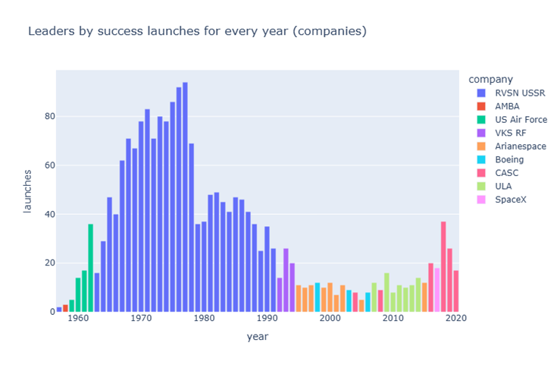
Leaders in Space Exploration (companies)
RVSN USSR stands out as a consistent leader during the Cold War era, followed by emerging companies like SpaceX and CASC in later years.
Although the USSR initially led in launches, the success rate improved significantly for other countries such as the USA, SpaceX, and CASC, especially after the 1990s in fig2.

Slide 28
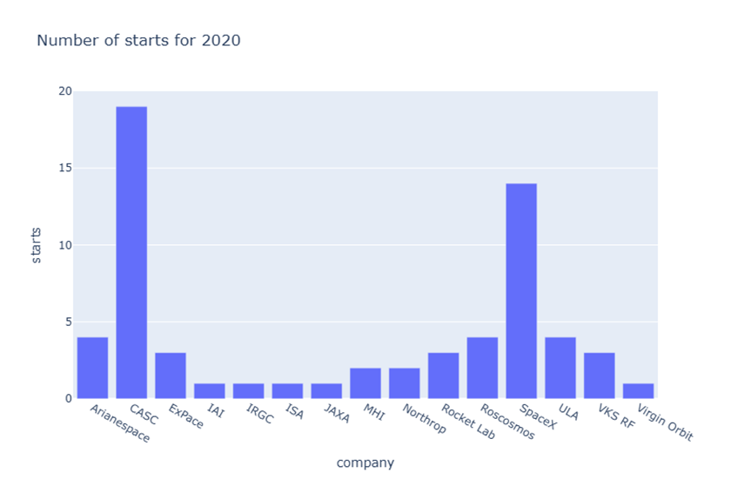
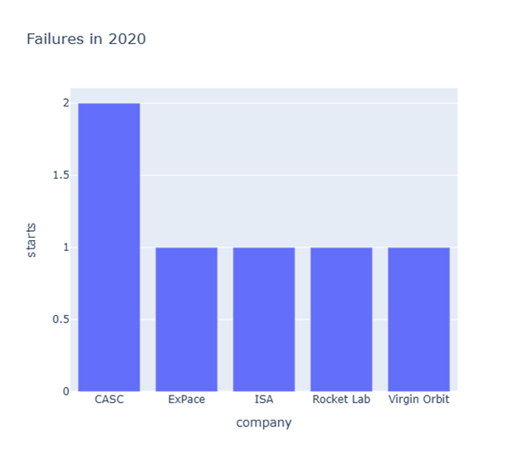
Historical Trends in 2020
CASC spearheads with the highest number of launches but faces challenges with reliability.
SpaceX excels in both volume and reliability.
CASC had the highest failure count, followed by other companies like ExPace, ISA, Rocket Lab, and Virgin Orbit, each experiencing one failure.

Slide 29
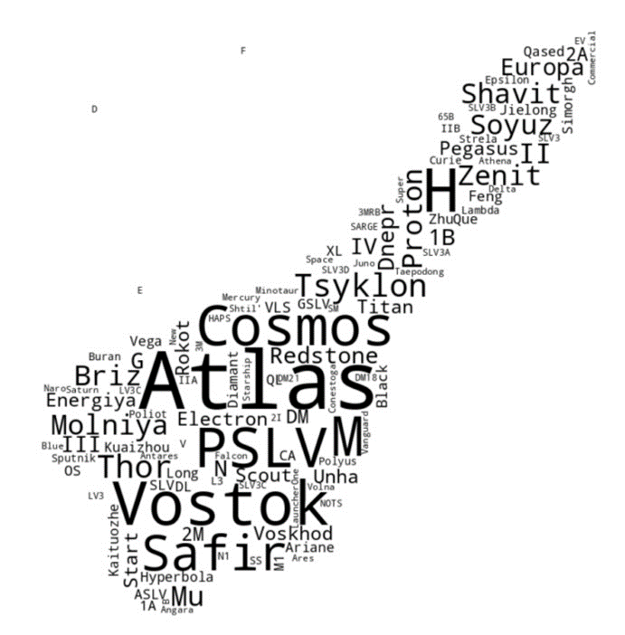
Launch Vehicle Trends in Word Cloud
Frequency Representation: The wordcloud visualizes the frequency of launch vehicles (LV) used across countries, with word size indicating usage prominence.
Custom Design: A thematic mask and color scheme (black text and firebrick contours) enhance visual clarity and aesthetic appeal.
Insightful Patterns: The visualization helps identify dominant technologies and trends in space exploration across different regions intuitively.

Slide 30
Objectives

Slide 31
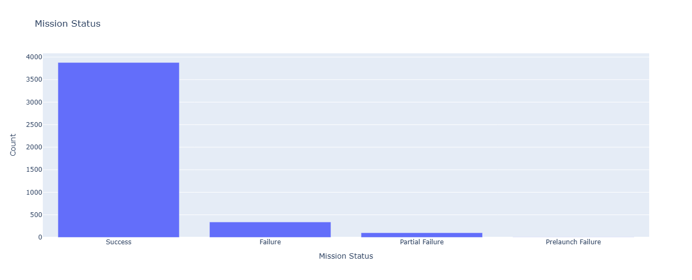
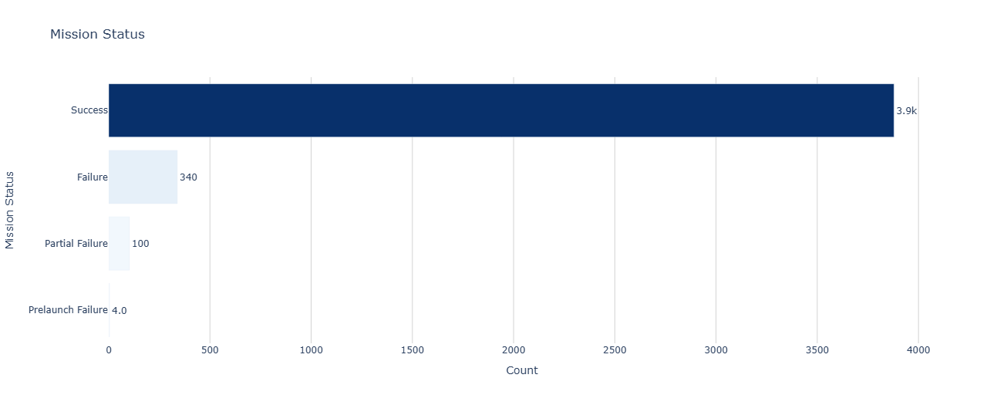
Mission Status Analysis
How do the distribution and status of space mission outcomes vary across different space programs, and how can we effectively visualize these trends to gain insights into overall mission reliability and efficiency?
Success Dominates: Over 90% of missions are successful, indicating high reliability.
Failures Are Rare: Failures (including partial and prelaunch failures) are infrequent, reflecting advancements in technology and risk mitigation.
Improved Visualization:
Horizontal Orientation: Simplifies the comparison across categories, especially for smaller ones like "Partial Failure" and "Prelaunch Failure.
Sorted by Count: Arranging bars in descending order makes it easier to identify the dominant and least significant categories.
Color Intensity: Highlights the largest category (Success) while visually reducing emphasis on less frequent outcomes, improving focus and readability.
Text Labels: Each bar displays exact counts, eliminating the need to infer values from axes.

Slide 32
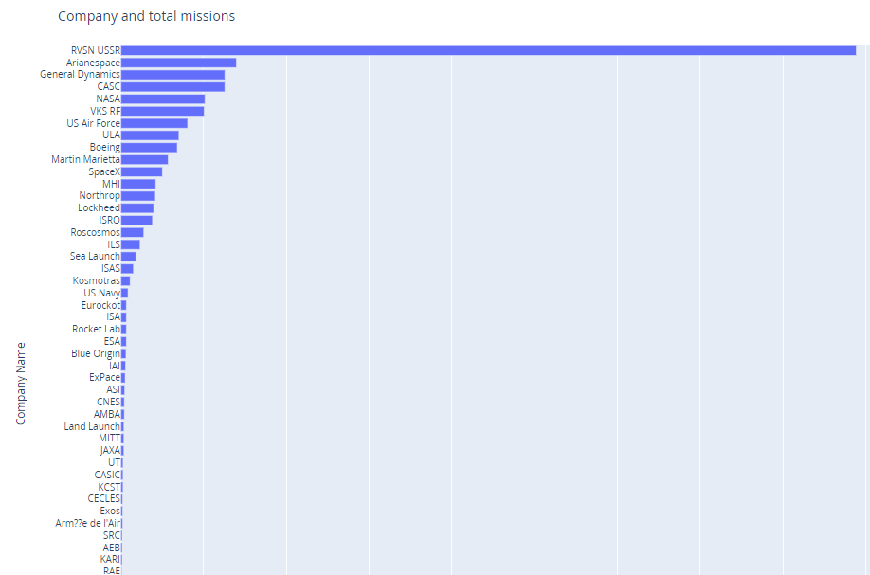
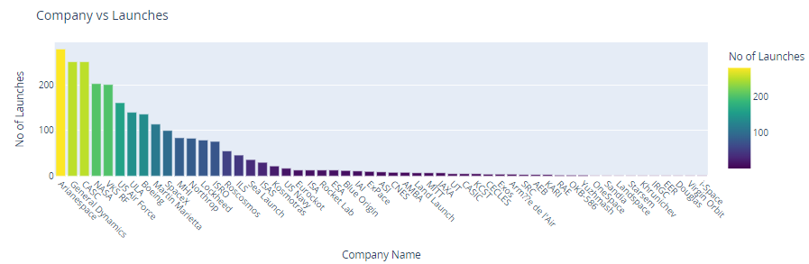
Company-Wise Launch Analysis
Which visualization method best captures the trends and cumulative contributions of space missions across different companies?
Figure 1: Vertical Bar Chart (Total Missions by Company)
Advantages: Simple and clear representation of total launches.
Limitations: Difficult to interpret differences between companies with smaller launch counts due to lack of emphasis on details.
Figure 2: Diverging Bar Chart (Colored by Number of Launches)
Advantages: Adds a color gradient to distinguish launch frequency effectively.
Limitations: Only focuses on total launches without emphasizing temporal trends.absolute scale, which may make interpretation less intuitive.

Slide 33
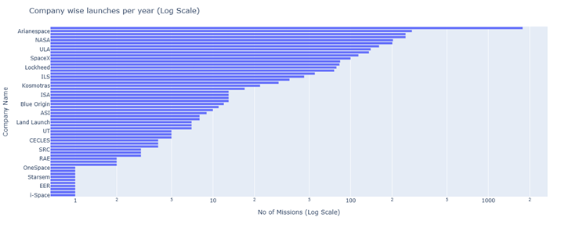
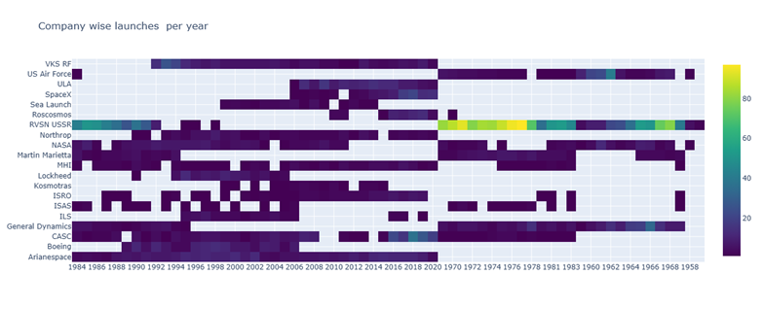
Figure 3: Logarithmic Bar Chart (Log Scale for Total Missions)
Advantages: Highlights disparities between companies with smaller and larger contributions using a logarithmic scale.
Limitations: Loses the absolute scale, which may make interpretation less intuitive.
Figure 4: Heatmap (Launches Over Time by Company)
Advantages:
Best visualization for understanding trends over time.
Highlights peaks and periods of inactivity for each company.
Effectively compares both legacy companies and emerging players.
Insights
Legacy Companies: Arianespace and NASA show consistent activity over decades, maintaining a diverse portfolio of launches.
Emerging Growth: SpaceX demonstrates a sharp increase in recent years, emphasizing its disruptive impact.
Market Dynamics: Gaps in company activity indicate shifts in strategy, reliance on specific collaborations, or market specialization.
RVSN USSR is the first company to venture into space industry and the performance was incredible with increasing number of launches every year and is the only company to launch 97 missions in a single year(1977) until it was collapsed in 1991.
There were not many companies in the space research at the beginning(1957) but we can see a tremendous increase in the companies now(2020).
These companies not only ventured but also maintained consistency in number of launches per year (SpaceX, VKS RF, Arianespace, ISRO)

Slide 34
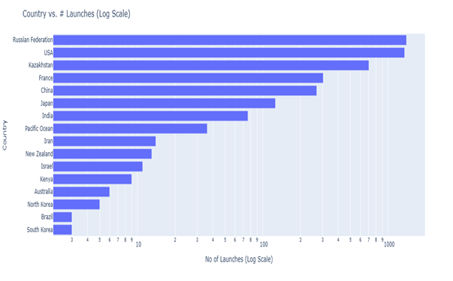
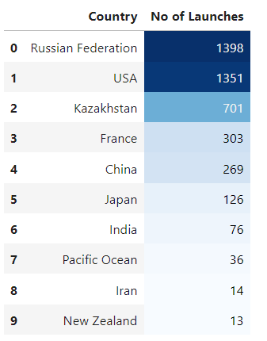
Country-Wise Launch Analysis
How do global space launch activities evolve over time across different countries, and what patterns emerge regarding the contributions and growth of major space programs?
Figure 1: Total Launches (Logarithmic Scale):
Highlights disparities between dominant players and smaller contributors.
Smaller countries like Brazil and South Korea are more visible due to logarithmic scaling.
Effective for showing contributions from countries with minimal launches.
Figure 2: Total Launches (Linear Scale):
Ranks countries by their total number of launches.
Shows Russia and the USA as leaders, with Kazakhstan, France, and China following.
Linear scaling provides an intuitive understanding of launch frequencies for dominant nations.
Both fail to reveal trends or evolution over time.

Slide 35
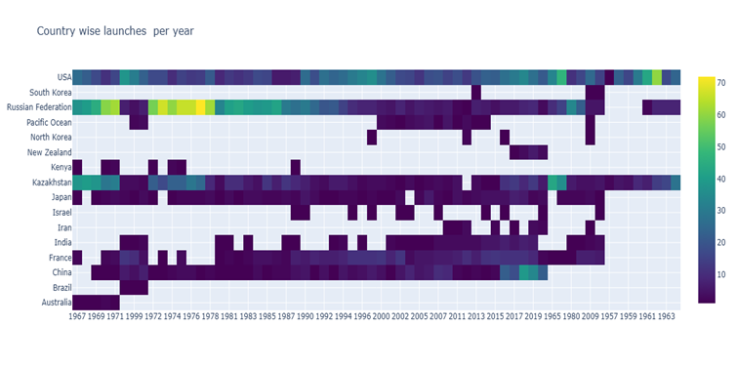
Why the Heatmap is Better?
Legacy Leaders: Russia and the USA maintain steady activity, reflecting their foundational roles in space exploration.
Emerging Players: China and India show increased activity in the 21st century, reflecting growing ambitions in the space industry.
Space Race: Kazakhstan (which was a part of Soviet Union) and USA were the first countries to launch rocket into space in 1957.The early era of space exploration was driven by a "Space Race" between the Soviet Union and the United States.
Temporal Trends:
Displays launch activity over time, making it possible to identify when specific countries were most active.
Highlights surges in activity (e.g., Russia during the Cold War and China's growth in recent years).
Comparative Insights:
Shows relative consistency for countries like the USA and Russia, while others like China and India display emerging trends.
Captures periods of inactivity or lower contributions for countries like Brazil and South Korea.
Depth of Information:
Enables identification of peak years and strategic shifts in global space exploration efforts.
Insights

Slide 36
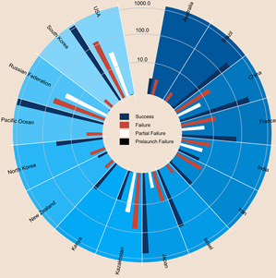
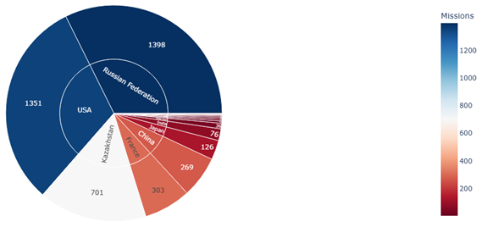
Mission Outcomes Across Countries
How can visualization techniques evolve to better represent mission outcomes across countries and companies while ensuring clarity and depth?
Radial Chart:
High-level overview of mission success rates across countries.
Strengths:
Easy to understand for basic country-level comparisons. Highlights dominant outcomes like "Success" visually.
Weaknesses:
Lacks deeper dimensions like company contributions or detailed outcomes. Poor hierarchy for drilling into specifics.
Initial Sunburst Chart:
Introduces a hierarchy (country-level breakdown). Clearer visualization of mission counts per country.
Strengths:
Better at summarizing mission frequencies. Maintains clarity while adding more data.
Weaknesses:
Still lacks company-level breakdown and granular insights.

Slide 37
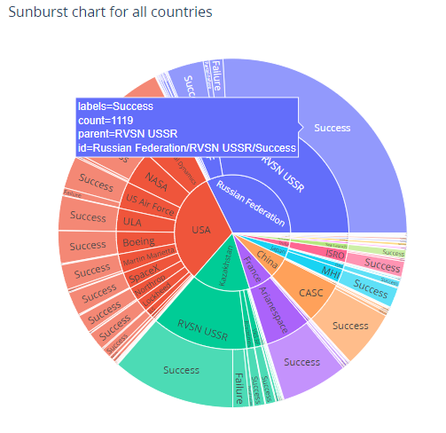
Evolution of Sunburst Charts – From Country to Company Insights
Overall Trends:
Countries like Russia and the USA dominate in total missions with high success rates. Emerging players (e.g., China, India) exhibit growing contributions.
Company Contributions :
USA’s success is heavily influenced by private companies like SpaceX. Legacy contributors (Arianespace, Roscosmos) show consistent results across decades.
Mission Outcomes:
Countries like Iran and Brazil display higher failure rates, reflecting technological or operational constraints.
From radial charts (high-level) to hierarchical sunbursts (granular details), the progression emphasizes depth and usability.
Insights
Hierarchy Integration:
Country > Company > Mission Outcome.
Each level provides actionable insights without overwhelming the viewer.
Granular Details:
Adds company-level contributions, showing how private vs government entities perform.
Breaks down mission statuses (Success, Failure) for each company.
Improved Usability:
Color-coded mission outcomes for better interpretation.
Maintains visual simplicity despite added complexity.

Slide 38
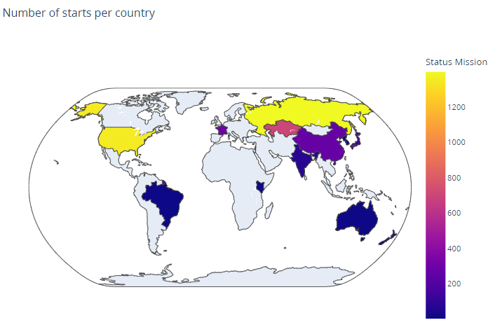
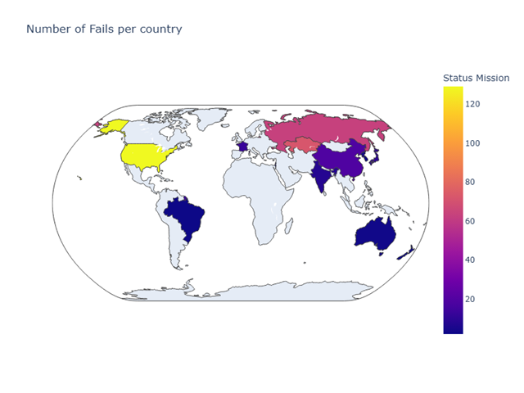
Geographic Analysis
How do countries with high space mission activity balance their success rates with the challenges of frequent failures, and what patterns emerge globally from this comparison?
Why Geo Analysis is Useful:
Geo analysis provides a clear spatial view of mission activity and failures, enabling easy identification of global trends. It aids in understanding regional disparities and highlights areas for technological investment or collaboration.
Combined Insights:
High Activity vs. High Failure Rates: Dominant nations like Russia, the USA, and China lead in launches but face high failure rates, showcasing the risks of ambitious programs.
Emerging Nations: Countries like India and Brazil have fewer launches and lower failure rates, reflecting a cautious and strategic approach to space exploration.
Risk-Reward Dynamics: A strong correlation exists between higher mission frequency and failure rates, emphasizing the trade-offs in scaling space capabilities.
Global Trends: Geographic patterns reveal the maturity of space programs, with high-performing countries driving innovation while others focus on foundational growth.

Slide 39
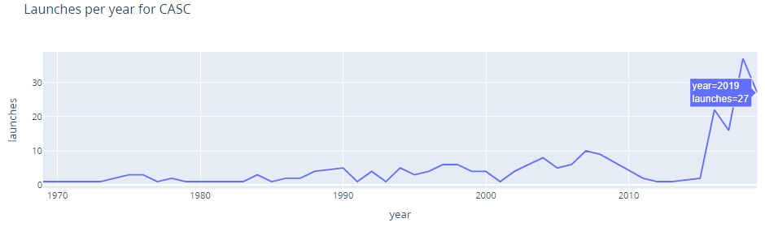
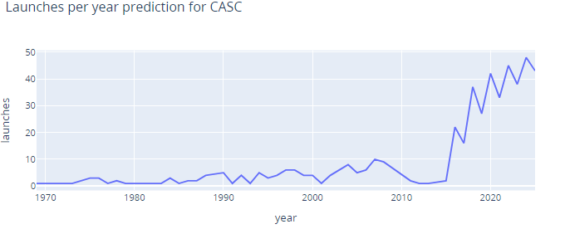
Predictive Modeling
How can predictive modeling help forecast the growth trajectory of space agencies like CASC and shape strategic decisions for future space exploration?
Historical Growth Analysis (Graph 1):
The first graph highlights CASC's exponential growth over time, particularly in recent years, showcasing the rapid expansion of China's space program.
Future Growth Forecast (Graph 2):
The prediction graph indicates continued exponential growth for CASC, projecting over 43 launches per year by 2025, driven by technological advancements and strategic investments.
Strategic Implications:
The model's insights can guide funding decisions, foster international collaborations, and help CASC maintain competitive positioning against global leaders like SpaceX and Roscosmos.
Identifying exponential growth trends allows stakeholders to plan infrastructure and resource allocation to support the expanding program.

Slide 40
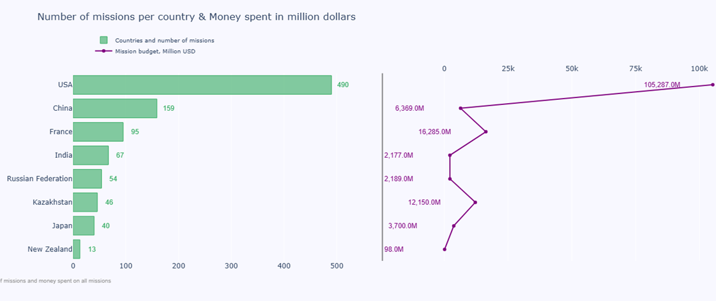
Budgetary Efficiency
Dominance of the USA: The USA leads with 490 missions and a massive $105,287M budget, reflecting its unmatched investment in space exploration. This underscores its global dominance and strategic focus on maintaining leadership in the field.
Efficient Players: India (67 missions, $2,189M) and France (95 missions, $6,369M) achieve significant mission counts with relatively low budgets. These countries showcase a focus on cost-effective and innovative approaches to space exploration.
Resource-Limited Efficiency: New Zealand (13 missions, $98M) highlights the efficient use of limited resources by targeting selective and impactful missions. This approach demonstrates the potential of smaller players to contribute meaningfully to the space sector.
Budget-Mission Disparities: Kazakhstan and Russia exhibit higher costs per mission, suggesting their focus on complex and heavy-lift missions. This reflects their preference for ambitious programs that may involve higher technological or operational challenges.
Strategic Implications: Collaborative missions and cost-effective technologies can help resource-constrained nations maximize their participation in space exploration. Leading nations can leverage their budgets to innovate, maintain dominance, and foster global partnerships.
How do budgetary allocations influence the efficiency of space missions across countries, and what patterns emerge from their spending and outcomes?

Slide 41
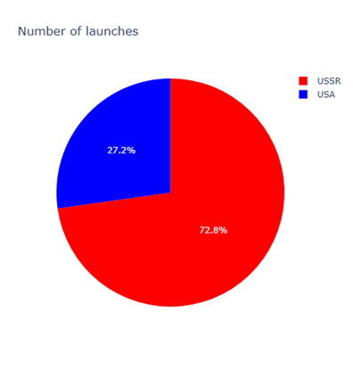

Space Race
How did technological strategies and organizational approaches influence launch rates and mission failures during the USA-USSR Space Race?
Total Launches (Pie Chart):
The USSR led with 72.8% of total launches, while the USA contributed 27.2% during the Cold War era, showcasing the USSR’s dominance in launch frequency.
Yearly Launch Trends (Bar Chart):
The USSR consistently outpaced the USA in yearly launches, peaking in the 1970s, highlighting the USSR's aggressive launch strategy.
Declines in the 1980s for both nations point to economic pressures for the USSR and a strategic shift for the USA toward quality over quantity.
Key Insight:
The USSR's state-centric model focused on volume, while the USA's measured approach reflected an increasing alignment with private-sector capabilities.

Slide 42


Company Contributions:
The USA showed higher involvement of private companies, peaking in 1990 with 7 companies, reflecting its strategy to leverage private-sector innovation.
The USSR maintained a centralized structure with limited diversity in company involvement, emphasizing state-driven programs.
Mission Failures:
Both countries saw significant declines in failures by the 1970s and 1980s, driven by technological advancements and improved mission readiness.
The USSR's higher failures in the 1960s suggest a riskier, volume-driven approach, while the USA maintained relatively lower failure rates.
Strategic Implications:
The USA's collaboration with private companies contributed to enhanced innovation and fewer failures.
The USSR's centralized approach achieved scale but faced challenges in mission reliability, reflecting the trade-offs between efficiency and innovation.

Slide 43

Key Results and Insights
From our analysis of space missions, we identified several important trends and insights:
1. Historical Trends:
Space Race (1960s–1970s) Surge:
The Cold War competition between the USSR and the USA fueled an unprecedented number of launches, particularly during the Apollo program era (1969–1972). This period saw significant technological advancements and ambitious milestones, such as lunar landings.
Renewed growth in the 21st century with private space companies:
The modern era is marked by the emergence of private companies like SpaceX, Blue Origin, and Rocket Lab, driving innovation. The exponential rise of China’s CASC in the last two decades highlights the shift toward diverse global contributors in space exploration.
2. Agency Contributions:
Government Agencies Domination:
NASA (USA) and Roscosmos (formerly USSR's RVSN) have historically been the most active, benefiting from substantial governmental funding and infrastructure.
Private Sector Emergence:
SpaceX and Rocket Lab have significantly increased their success rates despite taking on high-risk, innovative missions. They exemplify how private companies are closing the gap and reshaping the space industry.
3. Success Rates:
Government agencies have higher success rates overall due to decades of experience, advanced technology, and infrastructure.
Private companies, while increasing in prominence, face challenges due to innovation and rapid scaling, as seen in occasional mission failures from SpaceX and Rocket Lab.

Slide 44
Key Results and Insights
From our analysis of space missions, we identified several important trends and insights:
4. Geographical Insights:
Dominant Players:
The USA, Russia, and China are the leading countries in space exploration, with significant contributions from both government agencies and private enterprises.
Emerging Contributors:
Countries like India (ISRO) and Japan (JAXA) are gaining prominence with cost-effective and efficient missions.
Brazil and New Zealand have also emerged as launch centers.
Strategic Launch Sites:
Locations near the equator (e.g., French Guiana, India’s Sriharikota) are preferred for orbital launches due to reduced fuel requirements and advantageous orbital mechanics.
5. Temporal Patterns and Timing Insights:
Seasonal Trends:
Peaks in launches occur in summer (June to August) and December likely influenced by favorable weather conditions and project deadlines.
Time of Day:
Most launches happen during daylight hours ensuring clear communication, enhanced visibility and minimized risks.
Day of the Week Trends:
Most launches occur on weekdays, leveraging operational efficiencies, availability of personnel, and predictable weather assessments.

Slide 45
Data Challenges
1. Missing Data Challenge: Many entries lacked complete data, especially for costs in earlier missions.
Resolution: Used imputation for missing values or excluded incomplete rows to maintain analysis accuracy.
2. Inconsistent Naming Challenge: Variations in names across datasets (e.g., NASA as "N.A.S.A.").
Resolution: Standardized names using a mapping dictionary and ISO country codes for consistency.
3. Choosing the Right Charts Challenge: Initial charts were ineffective for large datasets with many categories.
Resolution: Replaced pie and bar charts with stacked bars, sunbursts, and heatmaps to improve clarity and detail.
4. Iterative Design Challenge: Visualizations needed refinement for clarity and depth.
Resolution: Applied best practices and tools like Plotly to create engaging and accurate visuals.

Slide 46
FUTURE DIRECTIONS
Incorporate Recent Data
Analyze data from missions conducted after 2020 to include recent developments and trends.
Predictive Modeling
Utilize advanced machine learning techniques (e.g., ARIMA) to forecast mission success, budget efficiency, and future launch trends.
Expand Dataset
Include more granular details such as payload types, costs, orbital classifications, and launch site conditions.
Global Collaboration
Identify opportunities for fostering partnerships between traditional space agencies and emerging private companies for planetary exploration.

Slide 47
Conclusion
Private Sector Emergence:
A paradigm shift post-2000 showcases the rise of private companies like SpaceX and Blue Origin, driving innovation, reducing costs, and increasing global accessibility.
Historical Significance:
The project highlights the Space Race as a critical period that laid the foundation for space exploration, with NASA and the USSR leading early advancements.
Future Potential: Predictive modeling and strategic insights indicate a collaborative future between government and private sectors, focusing on sustainable exploration of the Moon, Mars, and beyond.
Key Data Insights:
Analysis reveals patterns of launch frequencies, success rates, and geographical dominance, with the USA, Russia, and China as major players and emerging contributions from India and Japan.
Impactful Vision:
This project connects humanity's achievements in space exploration with its future potential, inspiring continued research and investment for the next era of discoveries.
Global Collaboration: The findings emphasize the importance of international partnerships and innovation, fostering advancements in technology and scientific exploration.

Slide 48
References
Kim, J., & Kaplan, M. (2019). Visualizing Space Exploration: Data-Driven Approaches to Mission Data. IEEE Conference on Big Data, Visualization, and Machine Learning, 84-91.
This DataSet was scraped from NextSpaceFlight.com and includes all the space missions since the beginning of Space Race (1957)

Slide 49
Thank you !

